Slide 1




Chemical hazard
Topic Learning outcomes :
Describe the definition of chemical hazard
Explains the chemical hazard and prevent strategies.

Slide 2


Chemical hazard Definition
A chemical hazard is a chemical that because of its characteristics and effects may cause harm to an individual.
Level of harm is impacted by ;
amount of chemical
time frame the exposure occurs
how the exposure occur (route of entry)
characteristic of the individual
Typical chemical hazard includes mists, vapors, gases, dusts and fumes.

Slide 3
Chemical hazard Definition
Routes of entry point of toxic chemical;
Once a chemical reaches the lower levels of the lungs, it can pass into the bloodstream and travel to a target organ where it will exert its effect
Inhalation
Skin
absorption
Chemical can be absorbed directly through the skin and into the bloodstream
Not a major concern in an industrial setting is entry through the mouth, but may occur if house keeping and personal hygiene practices are not adhered.
Ingestion
Is a route of entry for some chemicals, particularly drugs, where the use of needles is common in product handling, dispensing or delivery.
Injection

Slide 4
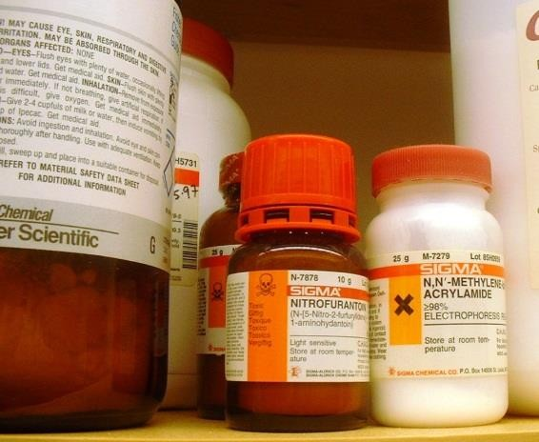
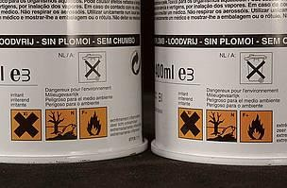
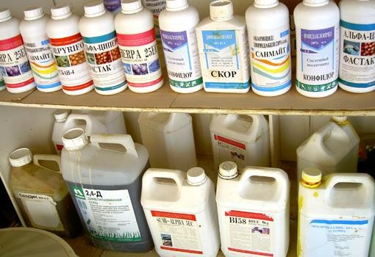
Chemical hazard Definition
Time frame the exposure occur;
Acute
exposure
An exposure to a substance over a brief period of time (usually 24 hours) that has an immediate or delayed impact on the exposed person.
An exposure to a substance that occurs over a long period of time, which allow to accumulate and cause toxic effects in the body.
Chronic
exposure
Types of hazardous Chemical

Slide 5
Identifying, assessing and control chemical hazard in industries
How to identify and assess chemical hazards :
List tasks that the worker performs and environmental factors where the worker is located
Step 1
Identify and list the chemicals to which the worker may be exposed
Step 2
Identify the potential for exposure to chemical substances through the various routes of entry
Step 3
Assess the hazard, evaluate potential exposure and determine the risk for exposure
Step 4
Identify appropriate controls following the hierarchy of controls
Step 5

Slide 6
Identifying, assessing and control chemical hazard in industries
Identify and list the chemicals to which the worker may be exposed
Step 2
Identify the potential for exposure to chemical substances through the various routes of entry
Step 3
How to implement Step 2 and Step 3:
Ensure the labels of incoming containers of hazardous chemicals are not removed or defaced.
Retain MSDS/CSDS on Incoming hazardous chemical.
What is MSDS/CSDS?
Material Safety Data Sheet (MSDS)/ Chemical Safety Data Sheet (CSDS) contains precautions for handling and using harmful substances and includes information such as health hazards, fire and explosion hazards, physical characteristics, hazardous ingredients, PPE and spill procedures.

Slide 7

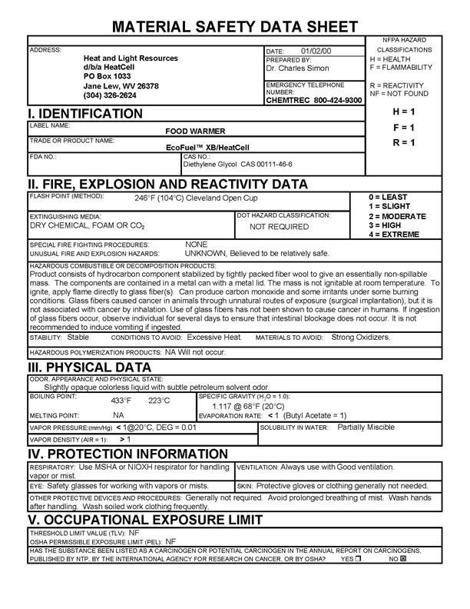
Identifying, assessing and control chemical hazard in industries
Example of MSDS

Slide 8
Chemical safety and handling procedure:
LABELS: Ensure the bottle has the correct product in it and correctly labeled. Do not use un labelled chemicals. Replace any labels, which are damaged or illegible.
CORRECT USE OF CHEMICALS: Always use chemicals as per the instructions on the label, product information sheets, Wall charts and on the Material Safety Data Sheet.
READ THE MSDS BEFORE YOU USE ANY CHEMICALS: Not all the information you need is on the label. It is your responsibility to always know where the chemical register is kept.
CHEMICALS – SAFE HANDLING: Do not mix chemicals, (It’s hazardous and can be counter productive). Do not “Top Up”, (It’s hazardous and can lead to cross contamination). Always use a clean empty container. Do not overdose.
RETURN CHEMICALS AFTER USE: When finished with chemicals, wipe down the bottle and store away safely in chemical cupboard.
ALWAYS WEAR APPROPRIATE PROTECTIVE CLOTHING: i.e. Aprons,
Gloves, Goggles or Glasses, Safety Footwear, Masks, etc (As per the MSDS).

Slide 9
Chemical safety and handling procedure:
REPORT ALL SPILLS, ACCIDENTS & ILL EFFECTS: Ensure Spill Kits are available and easily accessible. Remove spills as per MSDS directions. If unable to contain spills safely activate code YELLOW.
FIRST AID KIT: First Aid Kits should be easily accessible
NEVER STACK CHEMICALS MORE THAN 2 DRUMS HIGH: Stacking Chemical drums and boxes more than 2 high is unsafe and may fall causing damage. It is advisable to store powders above liquids.
IF IN DOUBT THROW IT OUT: If you are not sure of a product, label, etc.
Do not use it, notify your supervisor so it can be disposed of properly.
OBSERVE SAFE OPERATION OF DISPENSING EQUIPMENT: Ensure all staff knows how to operate chemical-dispensing systems safely.
USE OF CONTAINERS: Seal containers when not in use. Do not open
damaged containers, return them or seek advice from your supplier.
HYGIENE: Always wash your hands after using chemicals, (even if gloves were worn).
VENTILATION: Ensure there is adequate ventilation in the storeroom and
when using the chemicals.

Slide 10
Chemical safety and handling procedure:
SAFETY: If in doubt as to the correct use of the chemical, DO NOT USE
SMOKING: Do not smoke anywhere near the chemicals or whilst you are using the chemicals.
FOOD SAFETY: Do not use any chemicals near food.
CORRECT CHEMICAL, CORRECT JOB: Always use the right chemicals for the right job
PERSONAL PROTECTIVE EQUIPMENT: Always use and clean safety equipment after use.
MOST IMPORTANTLY USE COMMONSENSE: We must all take every precaution when using chemicals to ensure that individual safety and responsibility is optimised.

